Slide 1







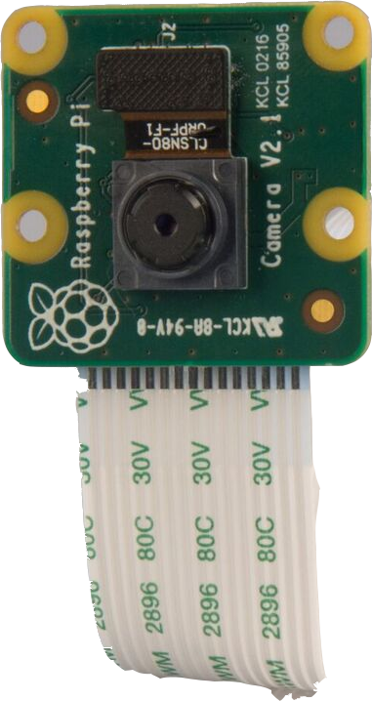



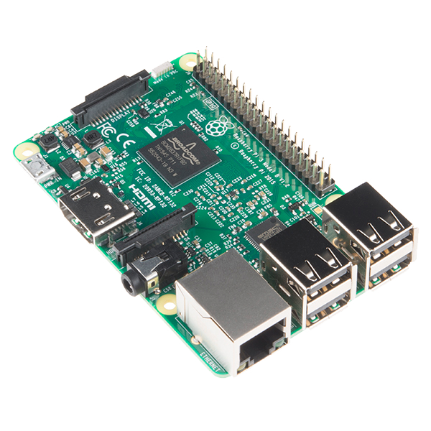

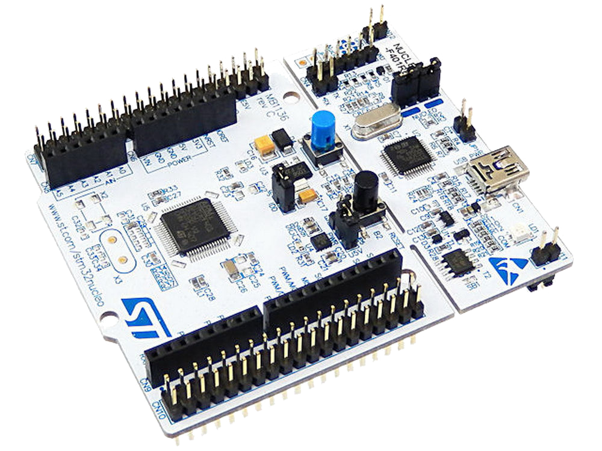

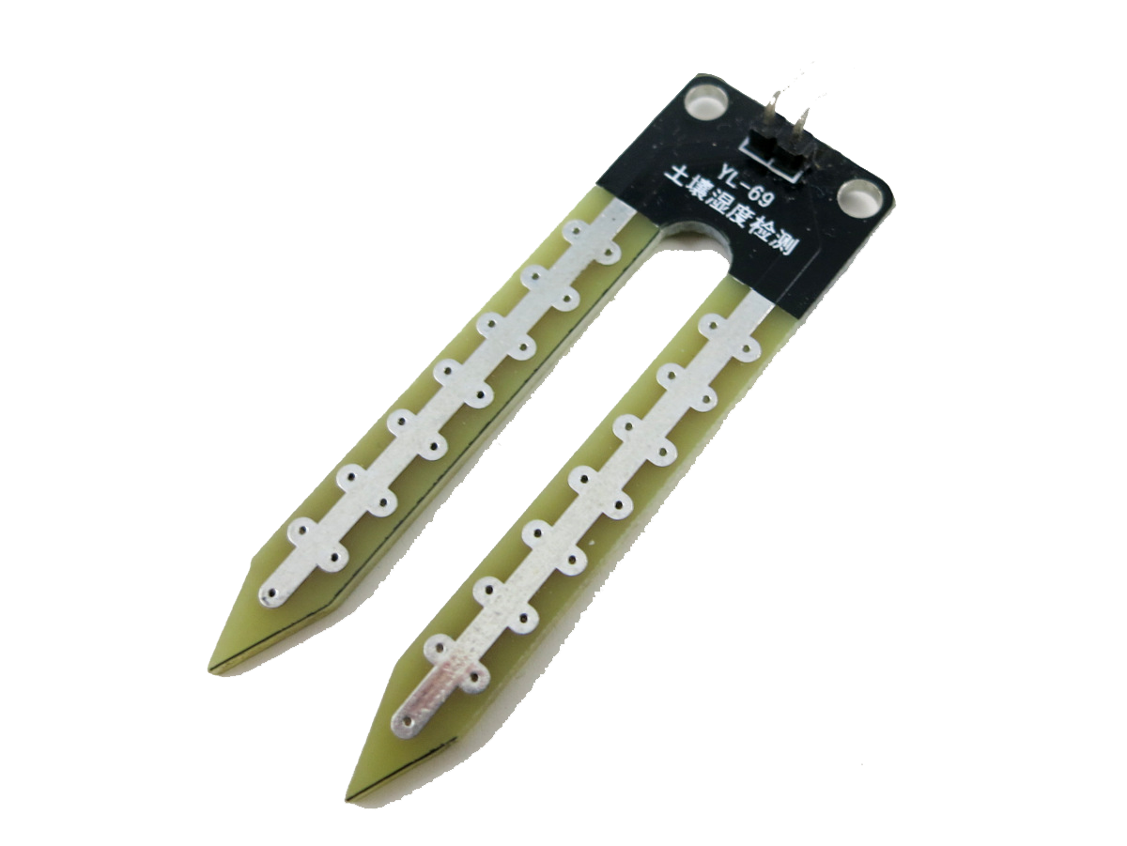






Hoykhom
King Mongkut's Institute of Technology Ladkrabang

Slide 2






Slide 3

Push and reply

Slide 4


Data Analytics

Slide 5
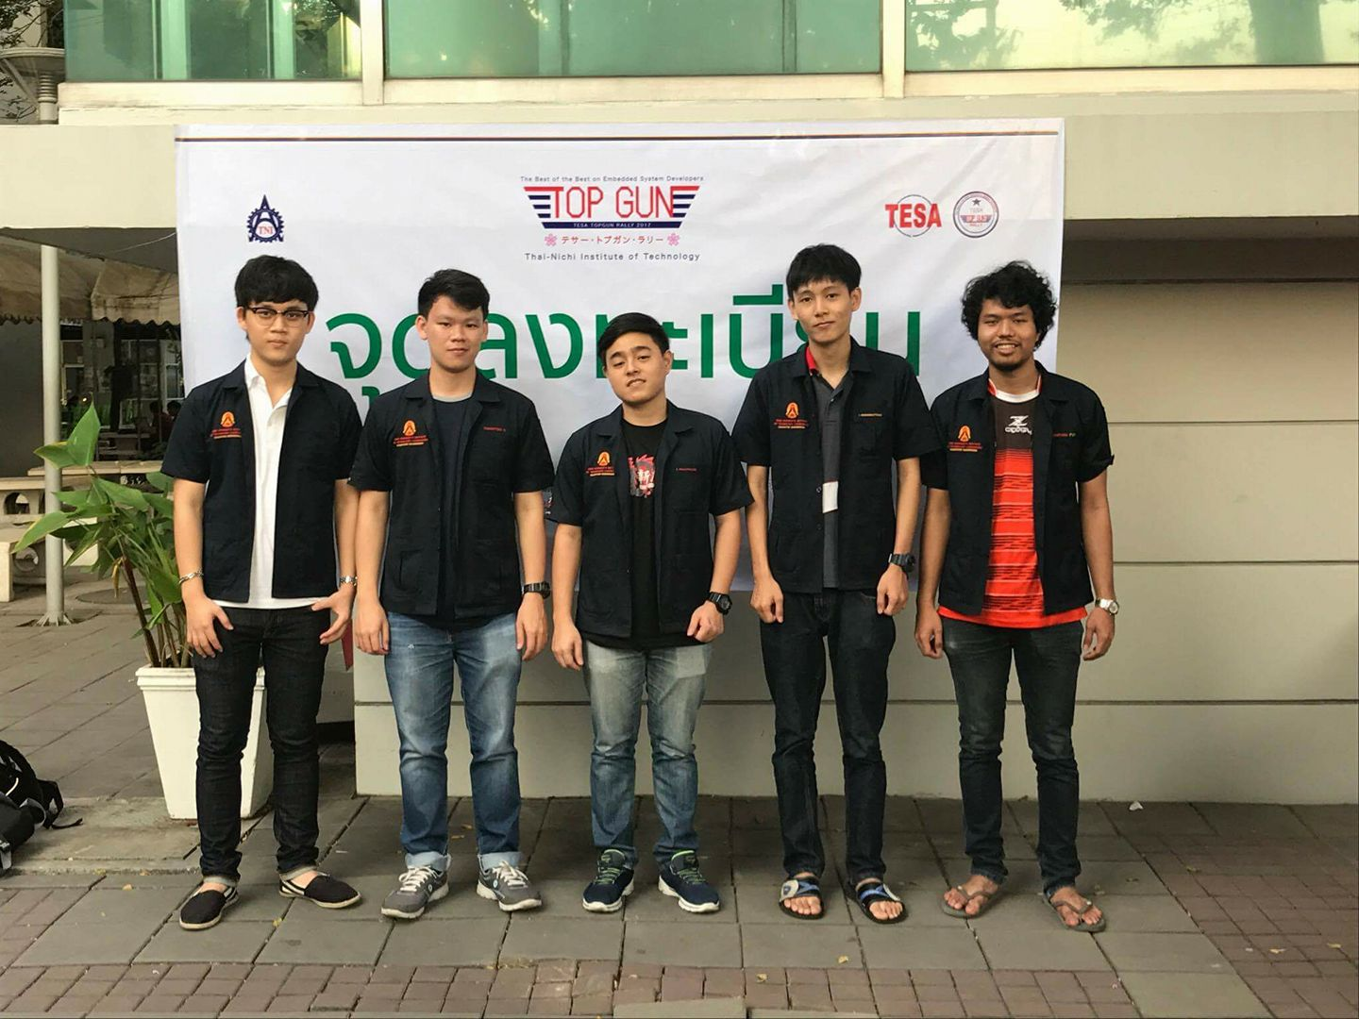
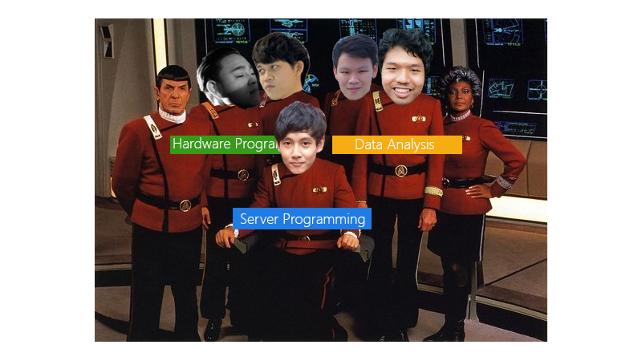
Teamworks!

Slide 6
Teamworks! (1)

Slide 7
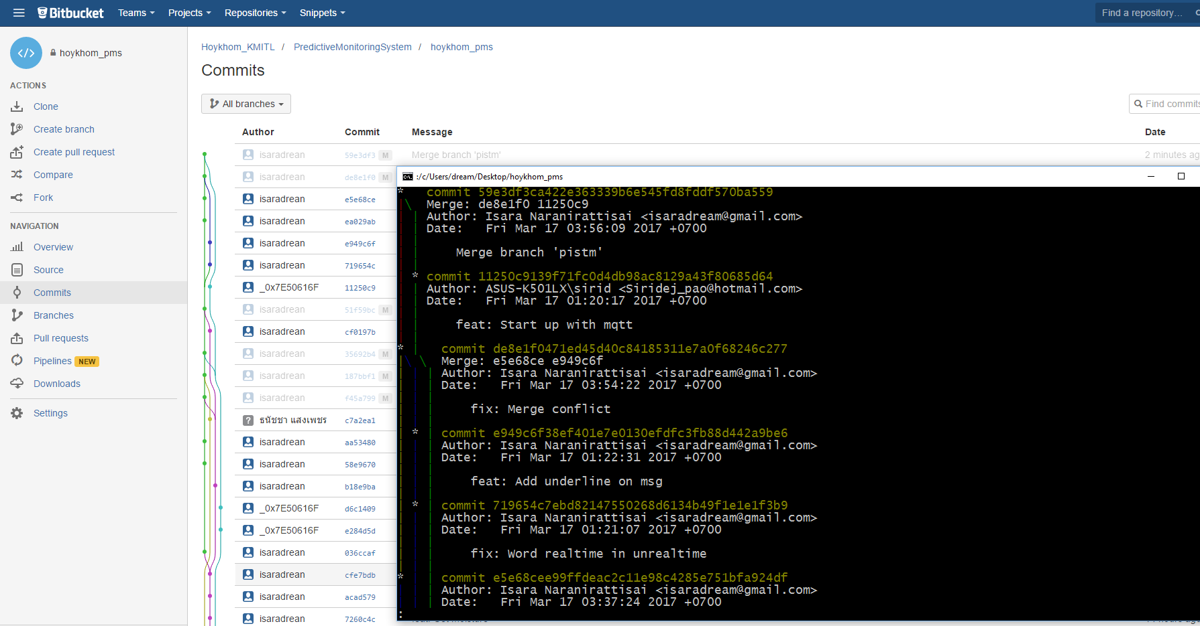
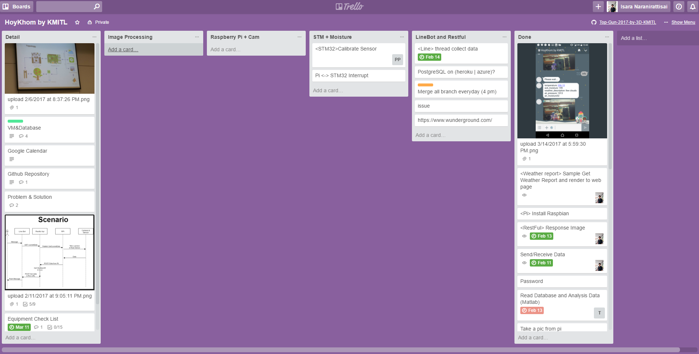
GIT <Bitbucket>

Slide 8
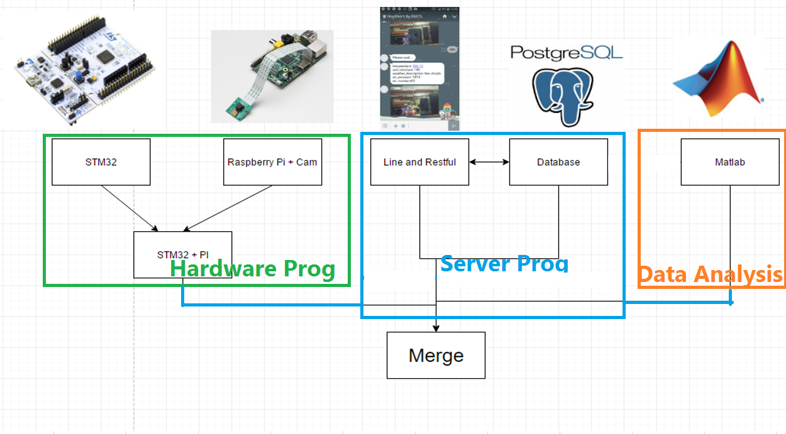
System Integration Strategy

Slide 9
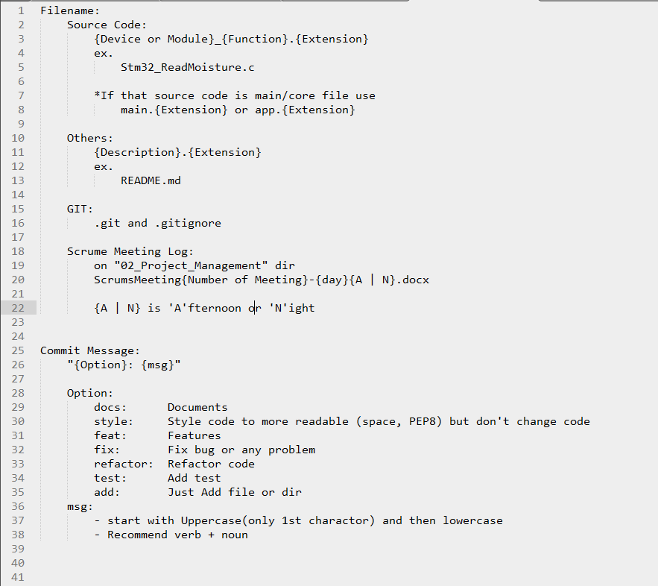
Naming Rules

Slide 10
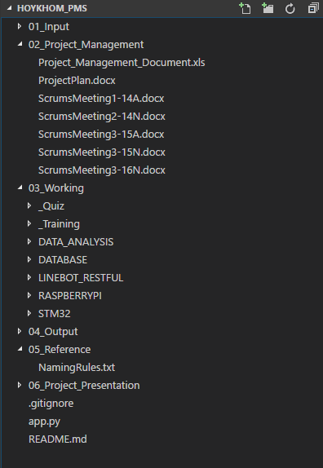
Directory Structure

Slide 11
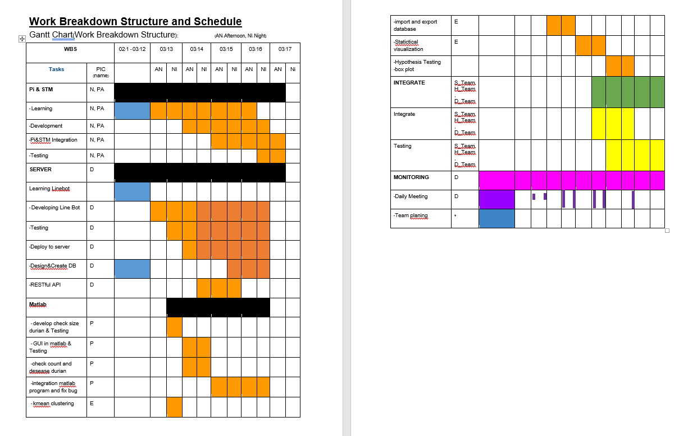
Working Breakdown Structure

Slide 12
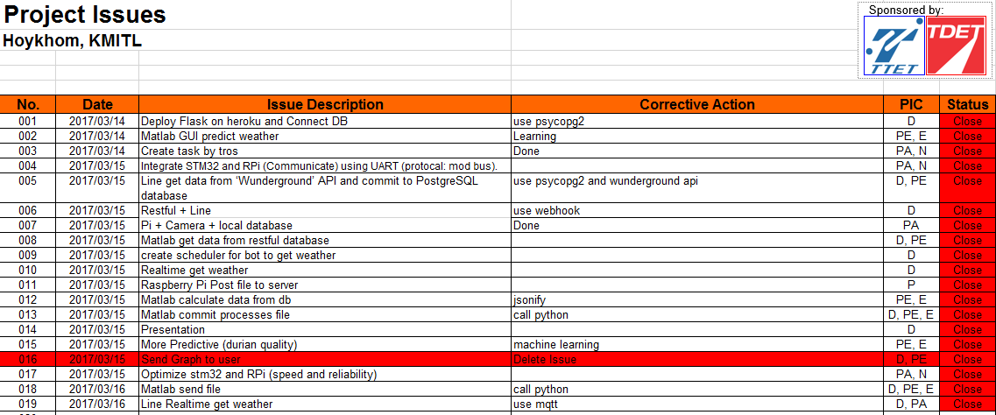
Project Issues

Slide 13
Before the competition

Slide 14
Because It’s our 1st time for TESA Top Gun Rally…

Slide 15
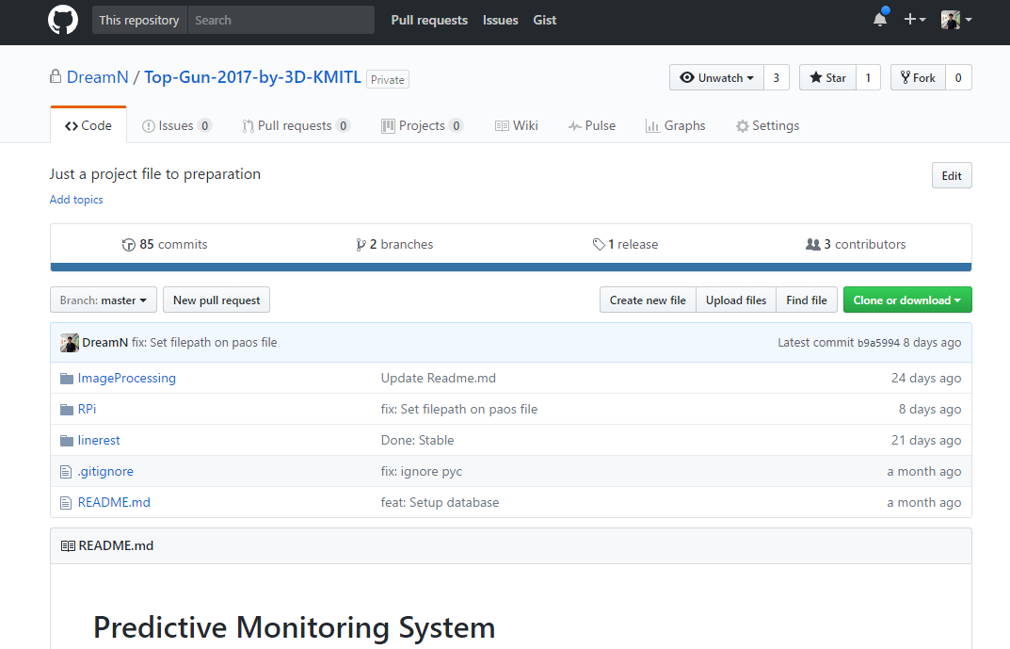
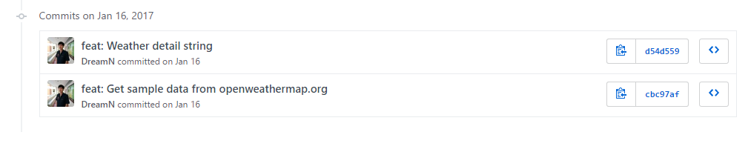
We’re practice so hard!
Over 80+ commits on github

Slide 16
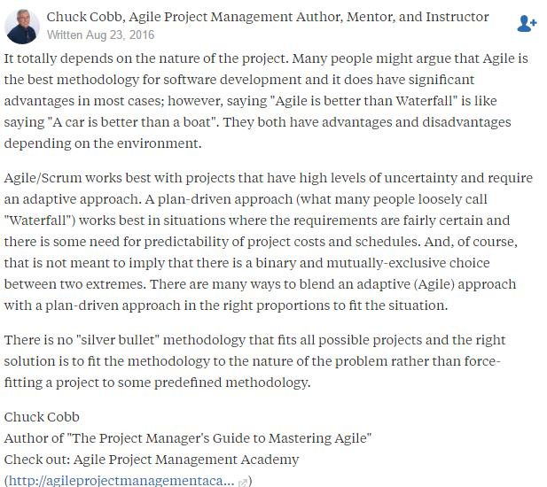

Slide 17
Trello

Slide 18
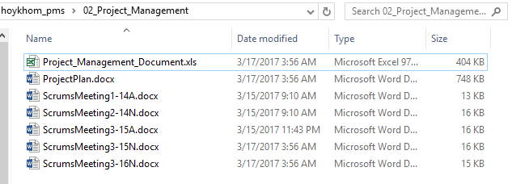
We talk 2 times a days

Slide 19
But we haven’t done yet…

Slide 20
Problem Analysis

Slide 21
Why STM32?

Slide 22
Why Raspberry Pi 3 ?

Slide 23
Why Matlab?

Slide 24
Why Heroku, Flask and psql?

Slide 25
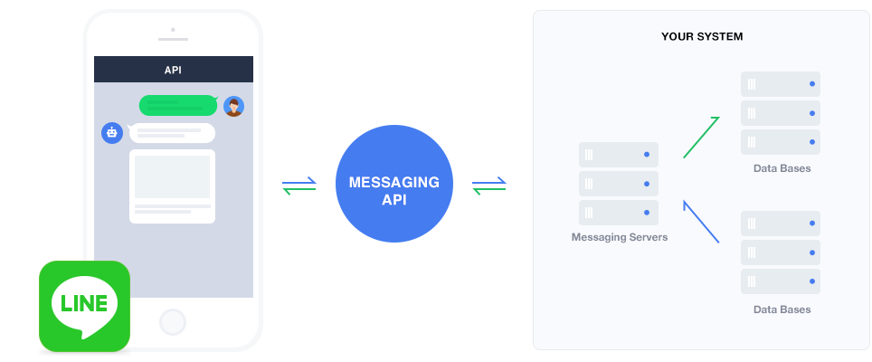
Why Line Bot API?

Slide 26
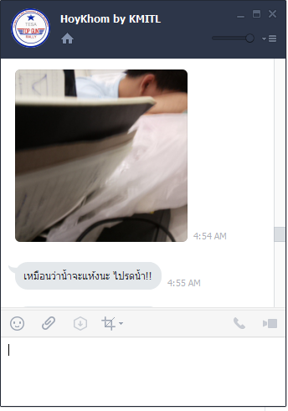
Why not just a web?

Slide 27
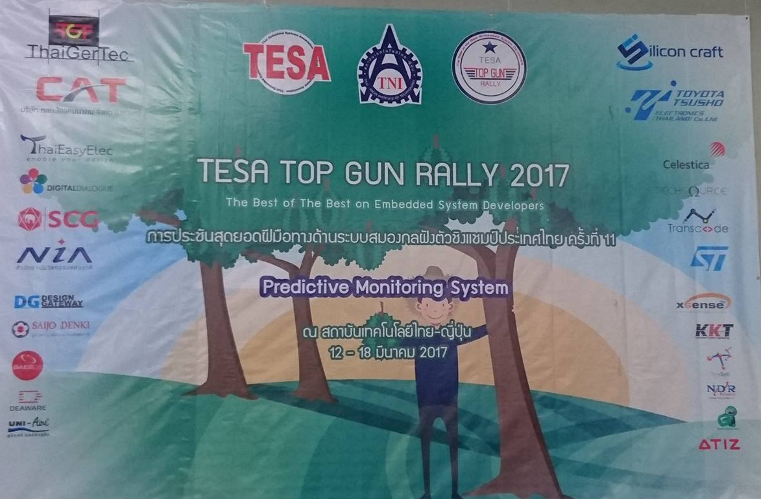
Thank You

